Slide 1
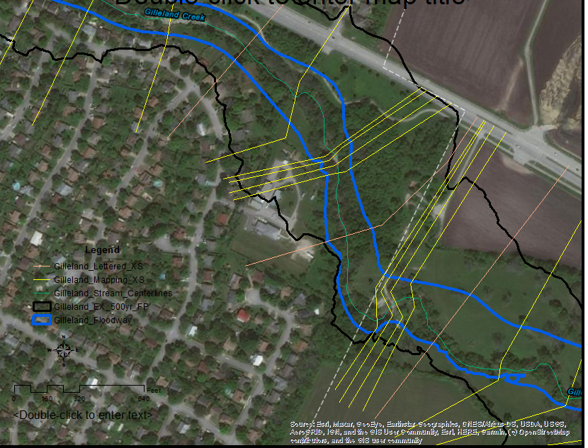
HEC RAS cross sections at Bike Trails downloaded from ATX Flood Pro

Slide 2
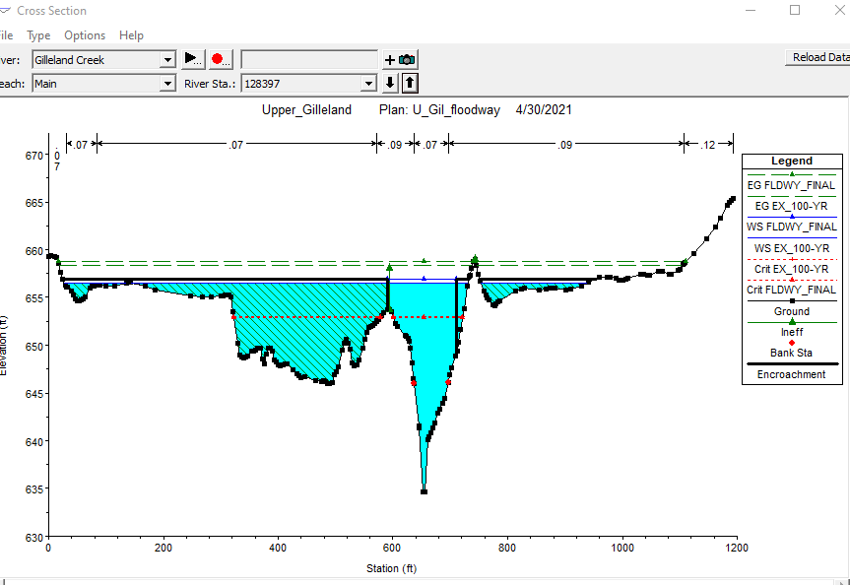
Cross section at upstream end
Trails are located on left side of cross section in area designated as ineffective flow

Slide 3
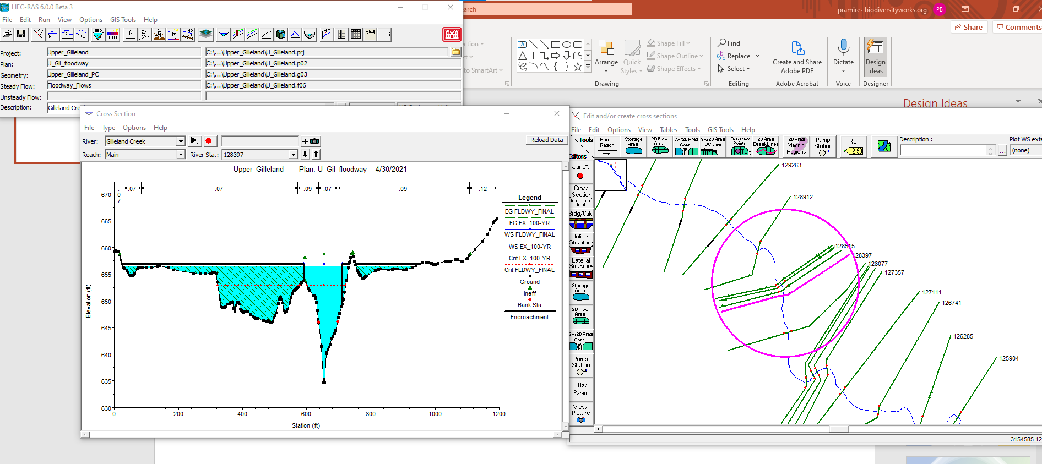

Slide 4
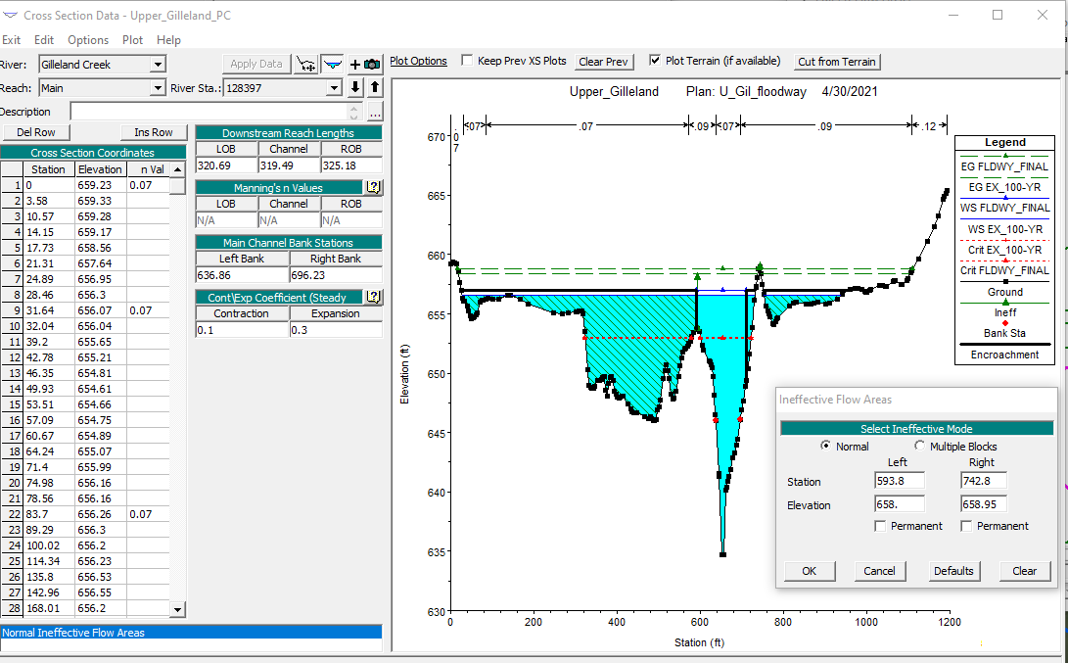
Ineffective flow areas

Slide 5
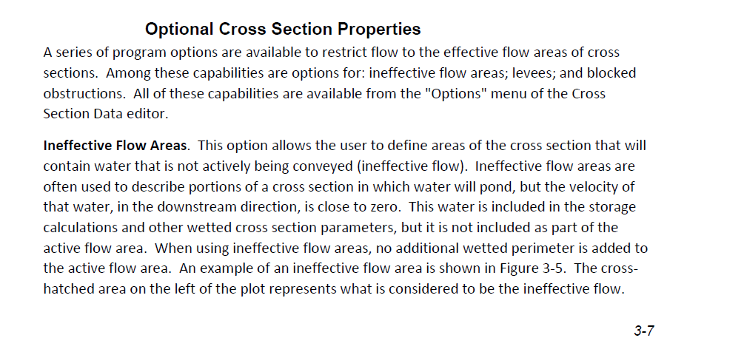
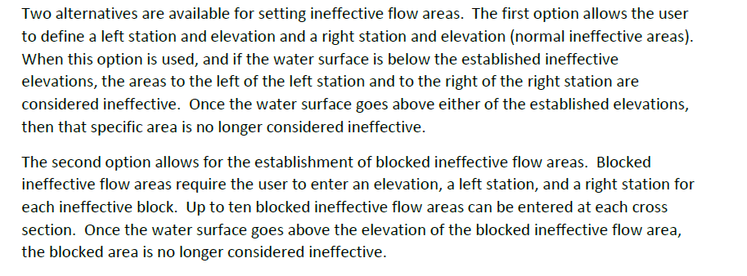
Ineffective areas in HEC RAS model
From manual

Slide 6
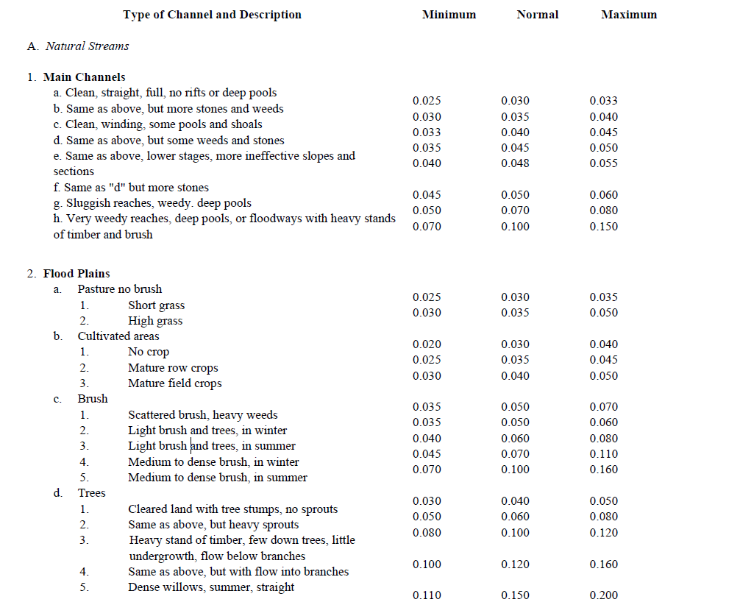
Roughness values
Typical values from HEC
RAS manual

Slide 7
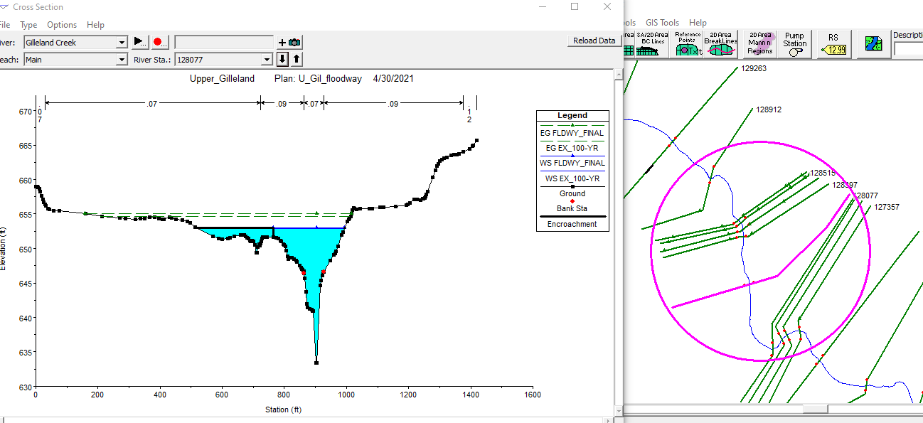
Cross section at downstream end

Slide 8
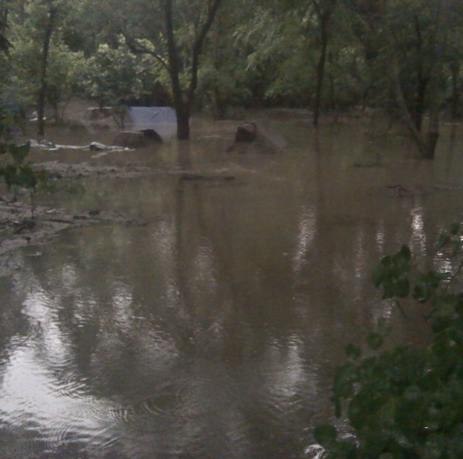
May 2015 flood
High water submerged trails, but flow was stagnant.
This observation agrees with HEC RAS model of “ineffective flow”

Slide 9
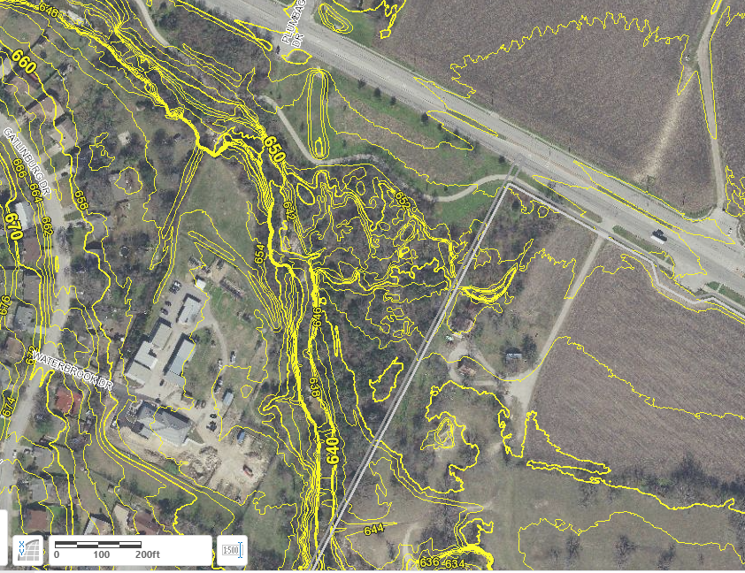
2017 elevation contours
From City of Austin Property Profile website

Slide 10
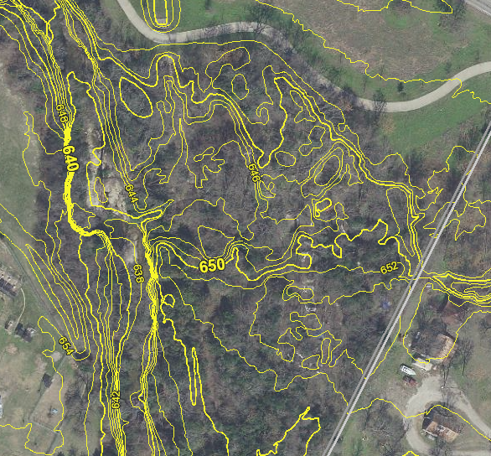
2017 elevation contours

Slide 11
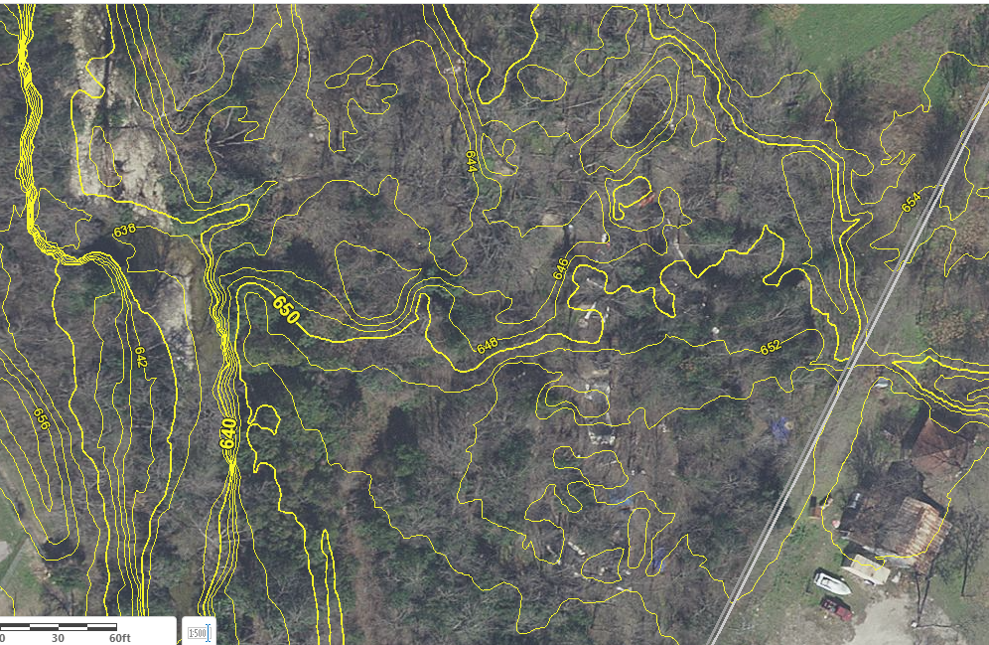
2017 elevation contours
Location of trails can be interpreted based on elevation contours and aerial imagery

Slide 12
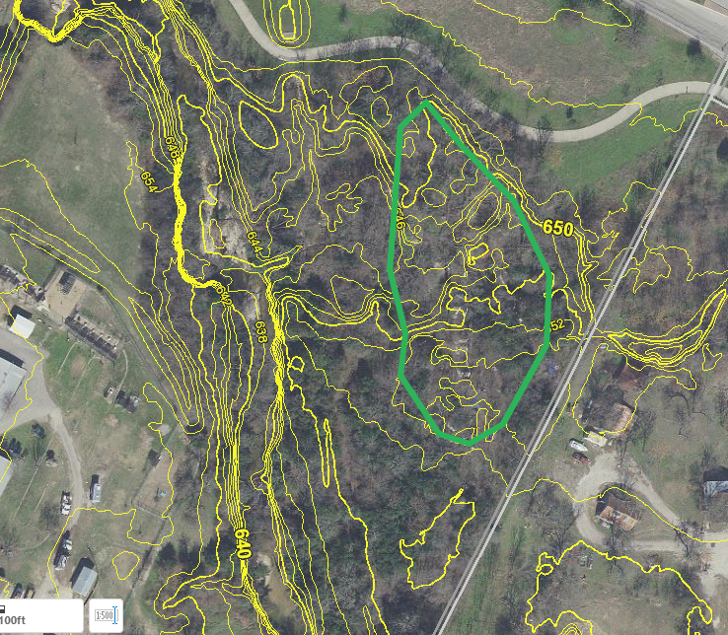
Floodplain storage
Bike trail area
Trails are situated on terrain above elevation 646 and below 654 in the floodplain.
Jumps created by excavating shallow pits and stacking and shaping soil into ramps and landings.
Trail features (jumps) were created without importing fill, so floodplain storage is not impacted.

Slide 13
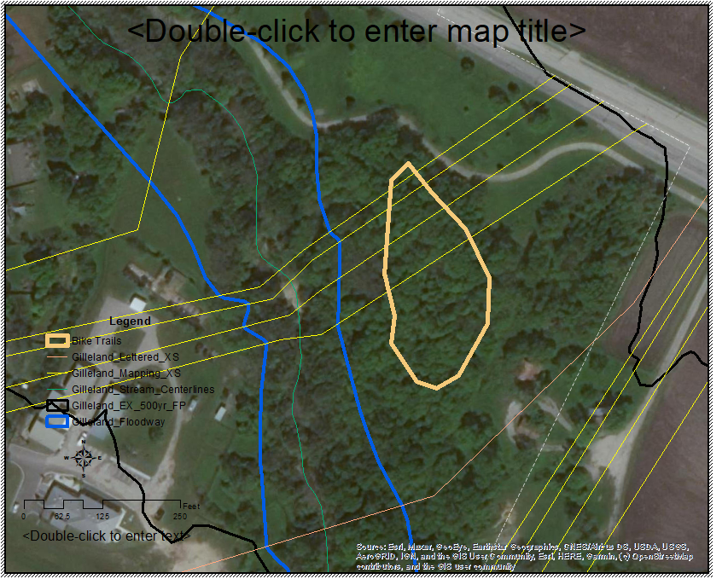
Flood flows
Trails are outside floodway and located in ineffective flow area
Located in area of scattered brush and heavy weeds (n = 0.07)

Slide 14
Erosion
Clay rich soils with cohesive properties
Exposed soil surfaces on trails and jumps is highly compacted by bike tires
Tarps used to cover exposed dirt mounds in event of heavy rain
Grass and vegetation planted on steep slopes on sides of features to hold soil in place
Above conditions tends to prevent soil erosion
When erosion does occur, sediment is captured in shallow pits (sediment traps) near jumps. No sediment is discharged to the creek.

